Slide 1
POCO C++ Library
http://pocoproject.org/
조욱래
2012-12-20

Slide 2
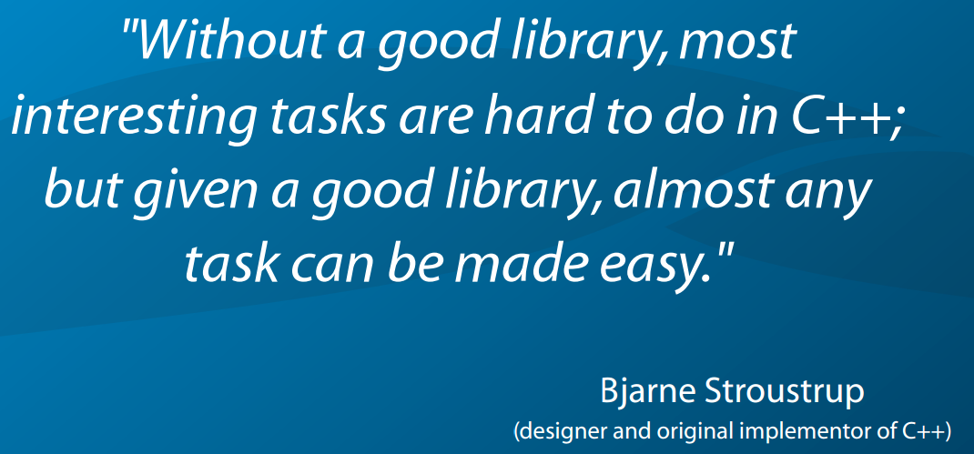
POCO C++ Library
http://pocoproject.org/slides/000-IntroAndOverview.pdf

Slide 3
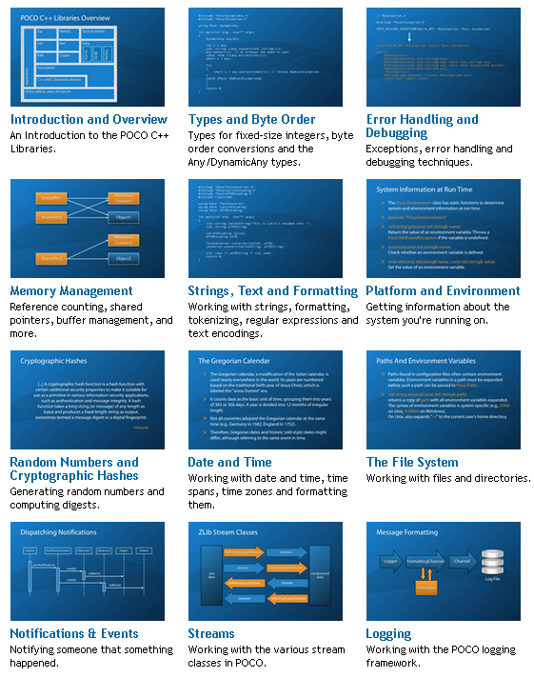
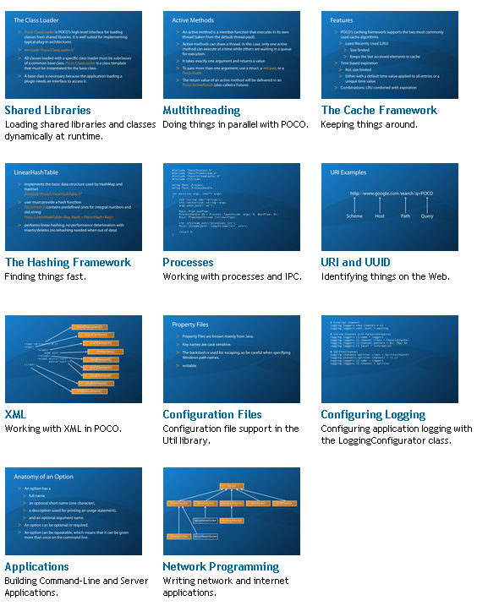
참고문서
http://pocoproject.org/documentation/index.html

Slide 4
open source C++ class libraries and frameworks
for building network- and internet-based applications
that run on desktop, server, mobile and embedded systems.

Slide 5
The POCO C++ Libraries are...
a collection of C++ class libraries, similar in concept to the Java
Class Library, the .NET Framework or Apple's Cocoa;
> focused on "internet-age" network-centric applications;
> written in eﬃcient, modern ANSI/ISO Standard C++ and based
on the C++ Standard Library/STL;
> highly portable and available on many diﬀerent platforms;
> Open Source, licensed under the Boost Software License,
> and thus completely free for both commercial and noncommercial use.

Slide 6
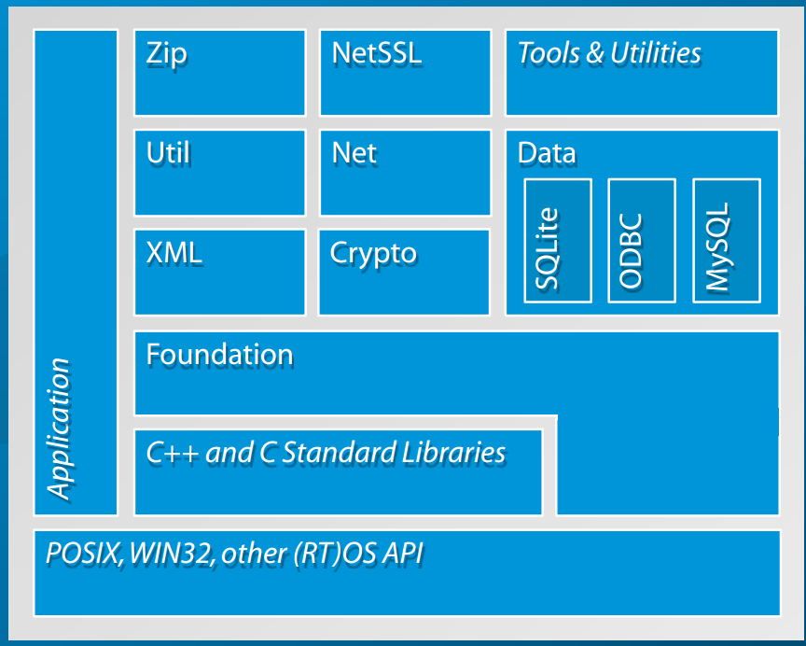
POCO C++ Libraries Overview

Slide 7
지원 Platforms
Desktop/Server:
Windows, Linux, Mac OS X, Solaris, HP-UX, AIX
Embedded/Mobile:
Windows Embedded CE, Embedded Linux (uClibc or glibc), iOS, Android, QNX, VxWorks
Minimum system requirements:
75 MHz ARM9, 8 MB RAM (Embedded Linux).

Slide 8
Core Features
Any and DynamicAny classes for dynamic typing
cache framework
date and time
events (signal/slot mechanism) and notifications framework
regular expressions (based on PCRE)
shared libraries and class loading
smart pointers and memory management (buffer, pool)
string formatting and string utilities tuples

Slide 9
그외 기능.
Compression(ZIP)
Cryptography(OpenS니 , X509, RSA)
Filesystem
Logging
Multithreading
Processes and IPC
launching and stopping, shared memory
Text Encodings
UTF-8 and Unicode handling
Utility Classes
command-line, configuration file
unix daemons and windows services
XML( Expat)

Slide 10
Database
SQLite, MySQL, ODBC
automatic data type mappings
collections support
(std::vector, std::set, std::map, etc.)
record sets and tuples
session pooling

Slide 11
Network
stream, datagram, multicast, server and raw sockets
TCP Server framework (multithreaded)
reactor server framework
HTTP(S) client and server framework
HTTP Basic and Digest authentication
C++ server page compiler
for embedding C++ code into HTML pages
FTP client
SMTP and POP3 client
for sending and receiving email
URI and UUID handling
HTML forms processing
MIME multipart messages
SSL/TLS support based on OpenSSL
WebSocket (RFC 6455) client and server

Slide 12
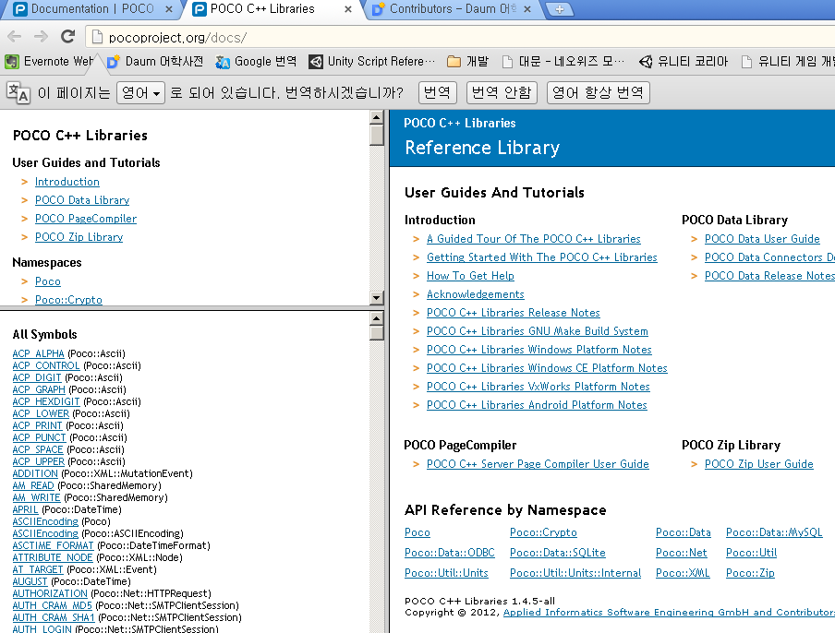
SDK reference.

Slide 13
Some Companies using POCO
454 Life Sciences (Roche)
using POCO in a new high-speed genome sequencer
> ACTIA Automotive
using POCO and OSP in automotive diagnostic systems
> Appcelerator Titanium
using POCO in its platform for Web-based desktop applications
> CACE Technologies
using POCO in its Pilot product for network monitoring/analysis
> CodeLathe Tonido
using POCO in its Tonido web application platform and device

Slide 14
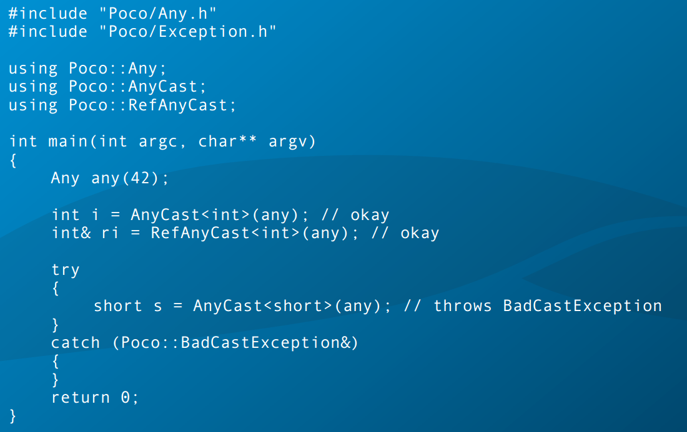
AnyCast

Slide 15
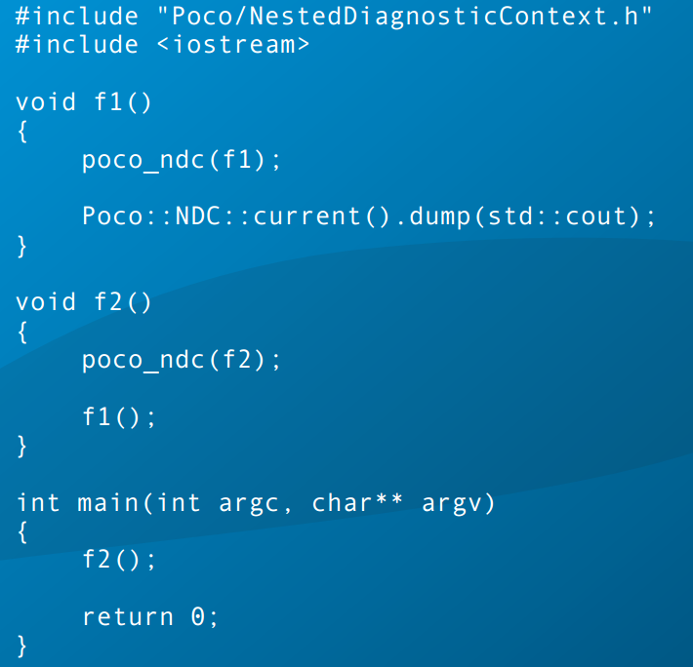
NestedDiagnosticContext

Slide 16
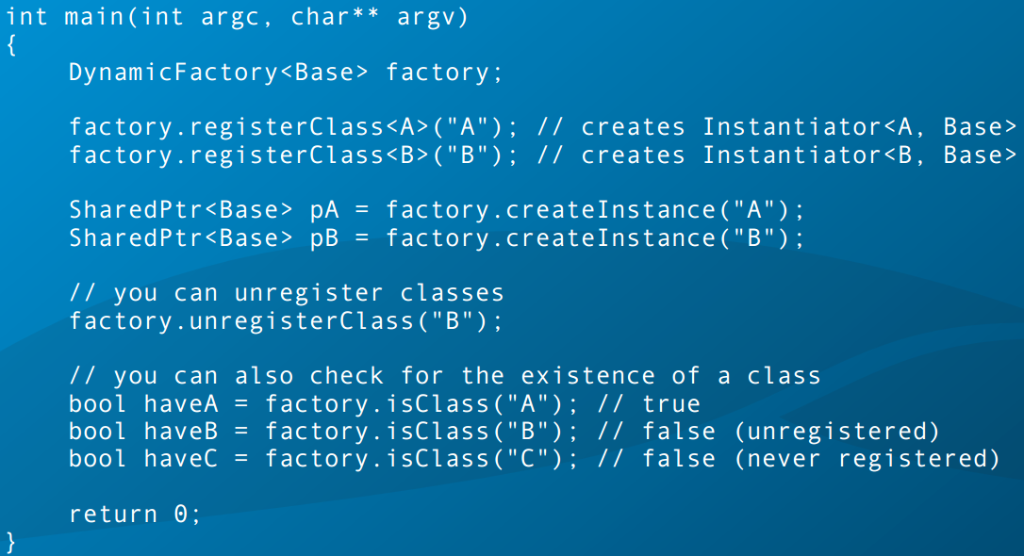
The DynamicFactory Class Template

Slide 17
Poco string lib

Slide 18
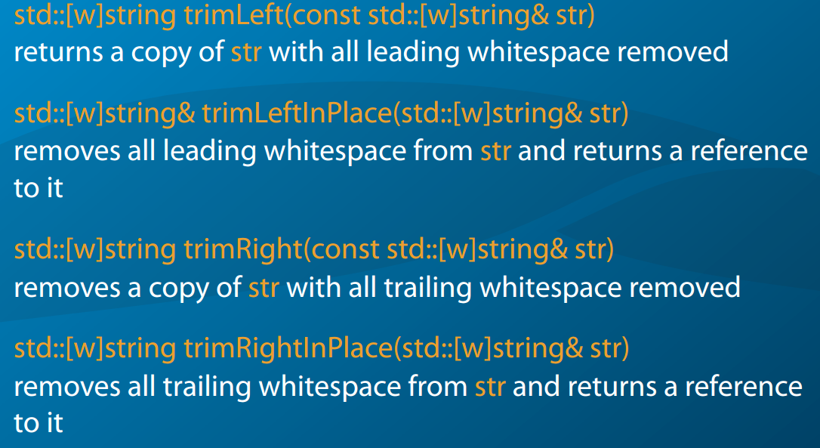
String Trimming

Slide 19
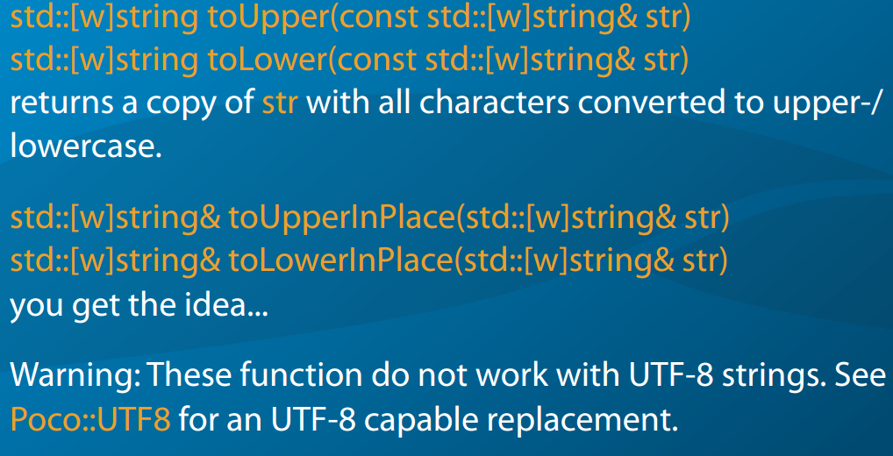
Case Conversion

Slide 20
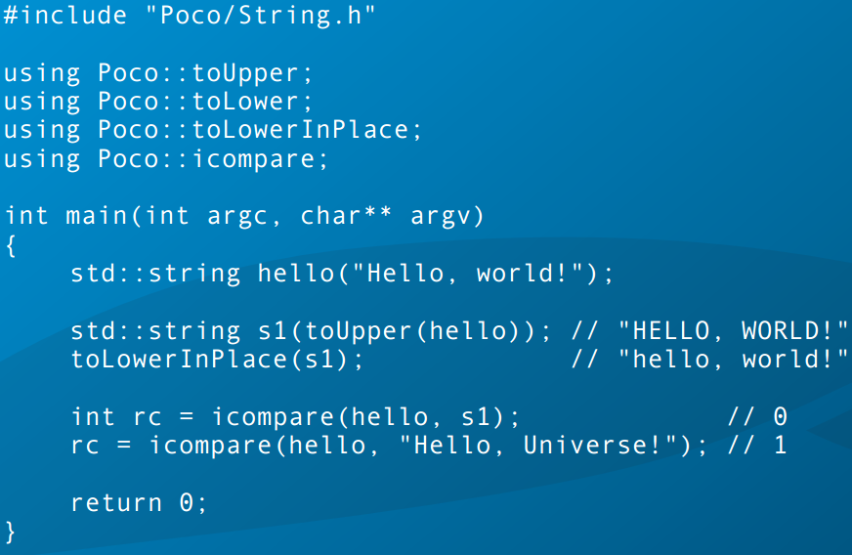
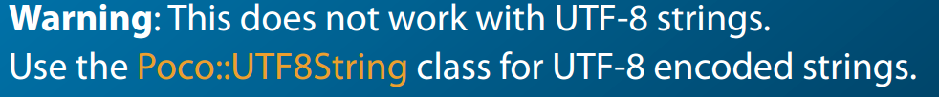
Case-insensitive Comparison

Slide 21
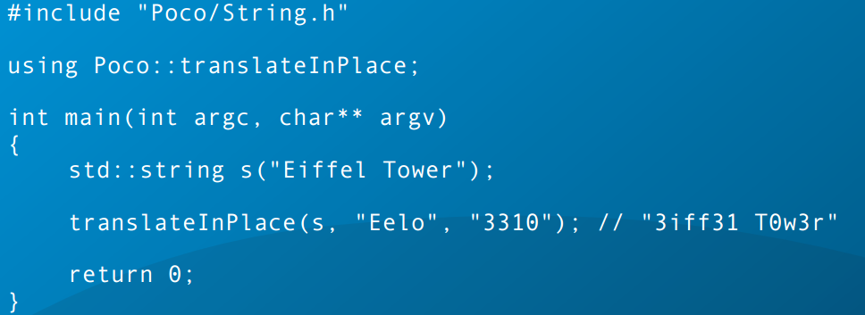
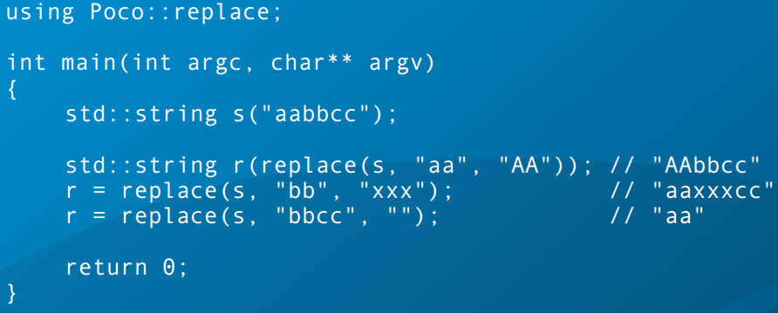
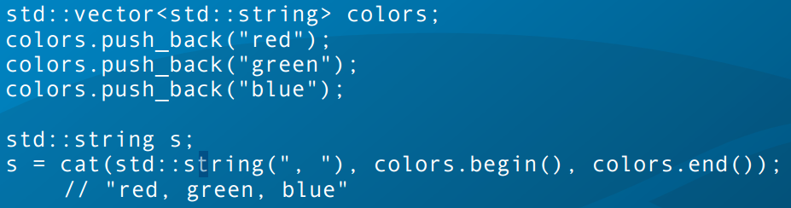
Character Translation

Slide 22
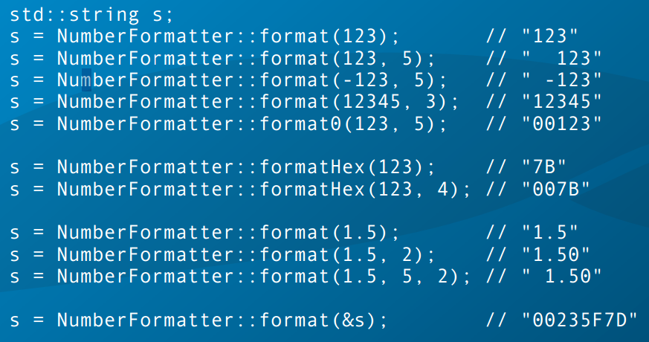
Poco::NumberFormatter

Slide 23
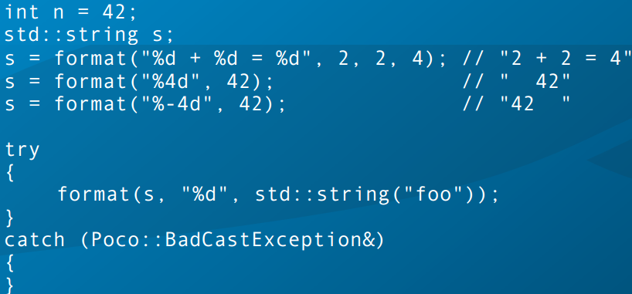
Typesafe Printf-style Formatting

Slide 24
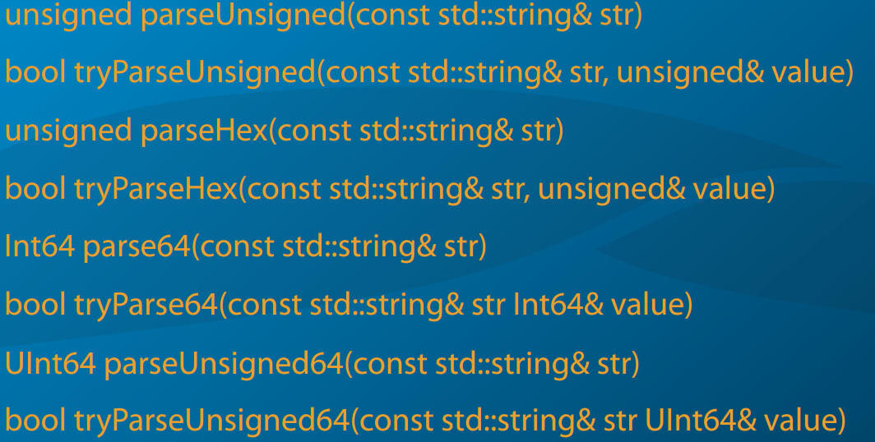
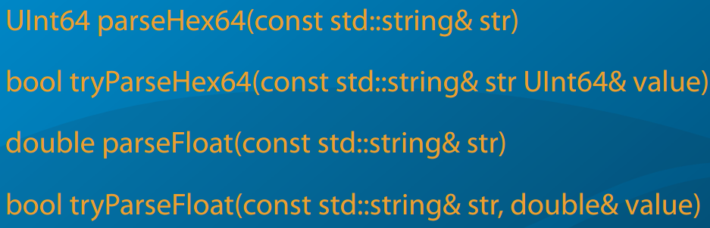
Extracting Numbers From Strings

Slide 25
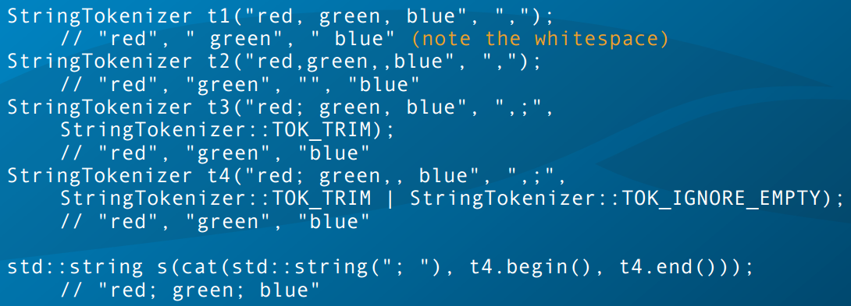
Tokenizing Strings

Slide 26
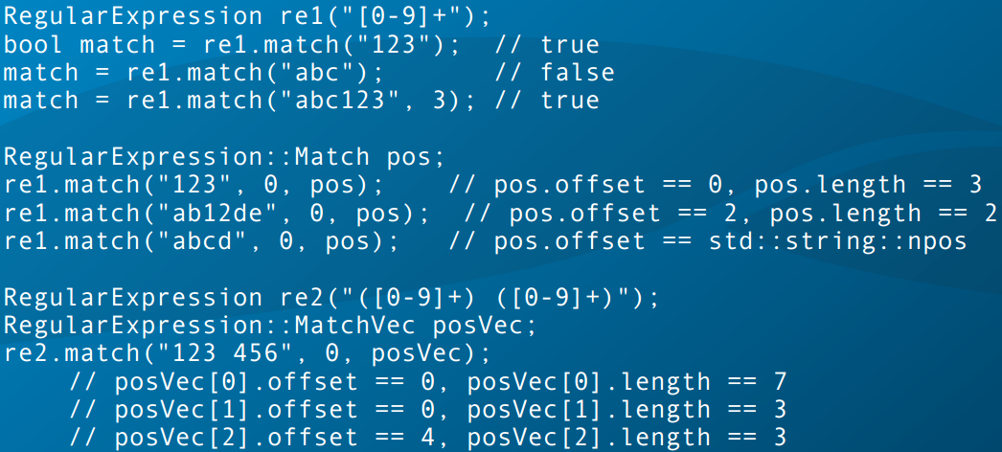
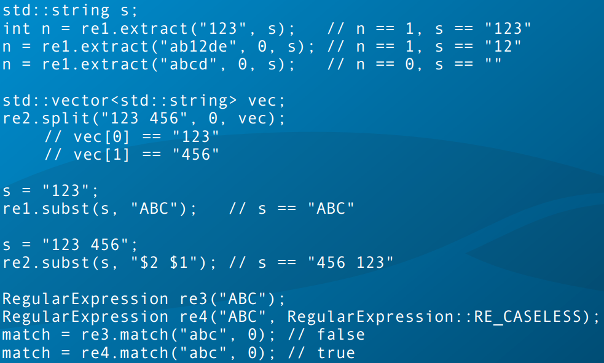
RegularExpression Class

Slide 27
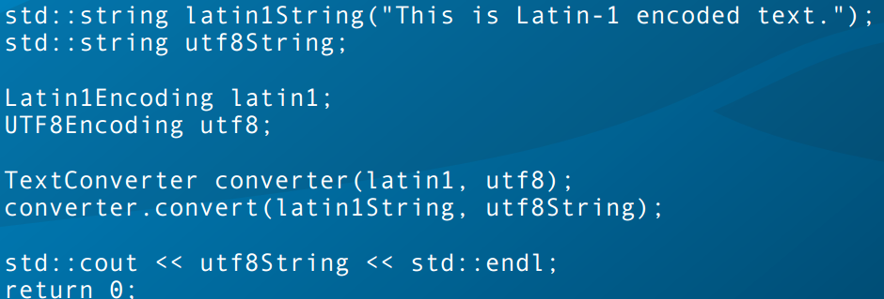
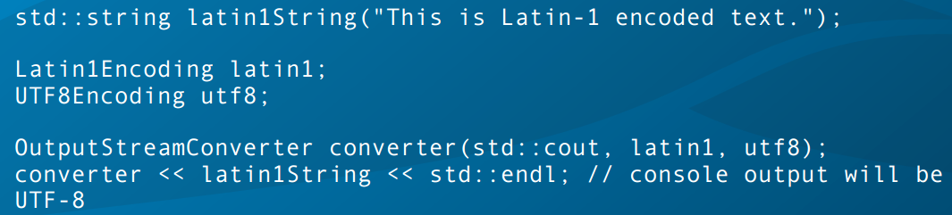
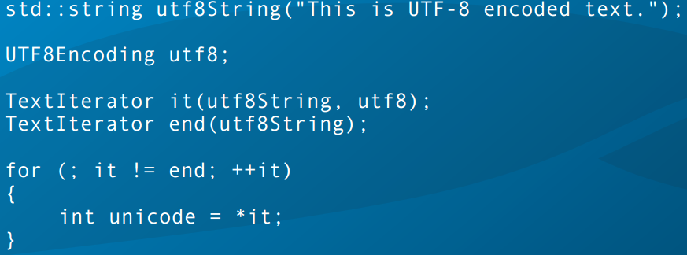
The TextConverter Class

Slide 28
PlatformAndEnvironment.

Slide 29
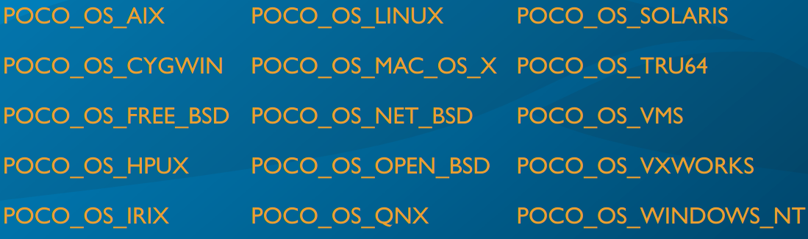
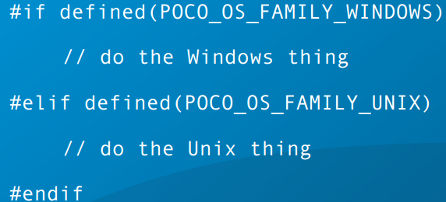
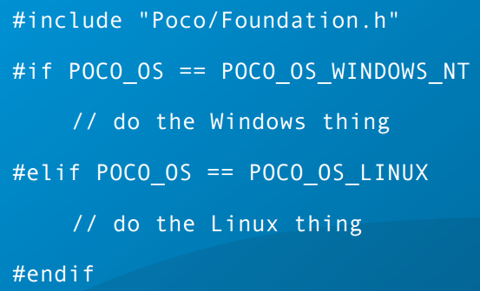
System Information at Compile Time

Slide 30
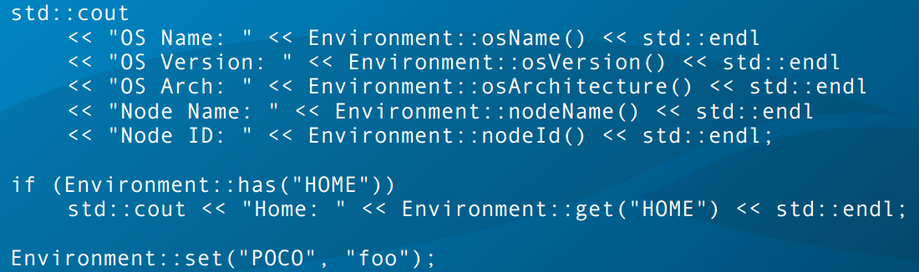
System Information at Run Time

Slide 31
Random Numbers and Cryptographic Hashes

Slide 32
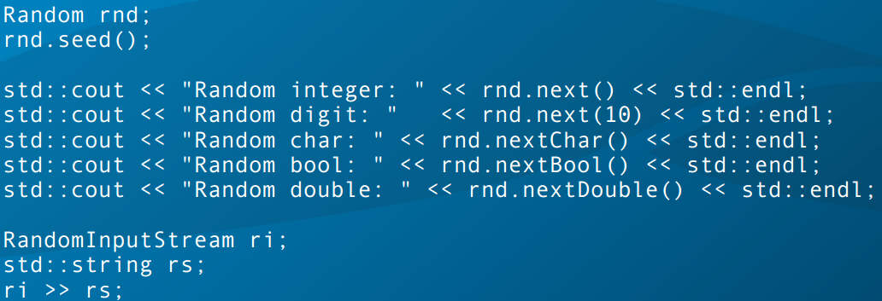
Random Class

Slide 33
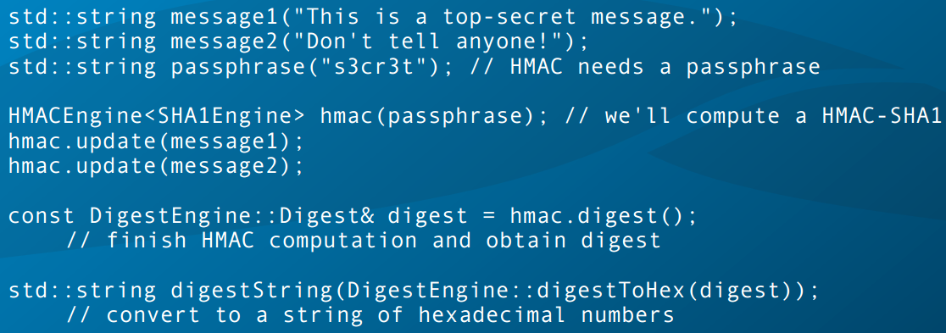
Cryptographic Hashes

Slide 34
Date and Time

Slide 35
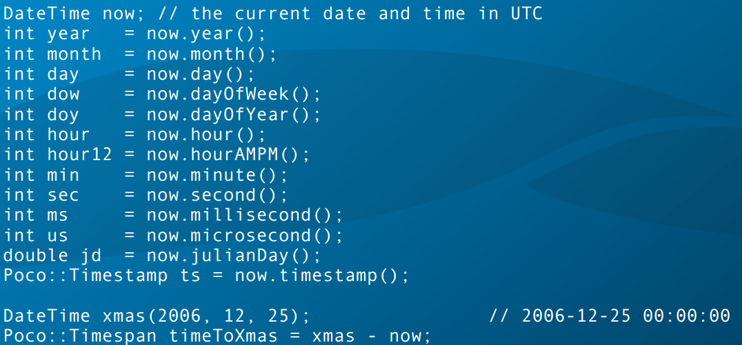
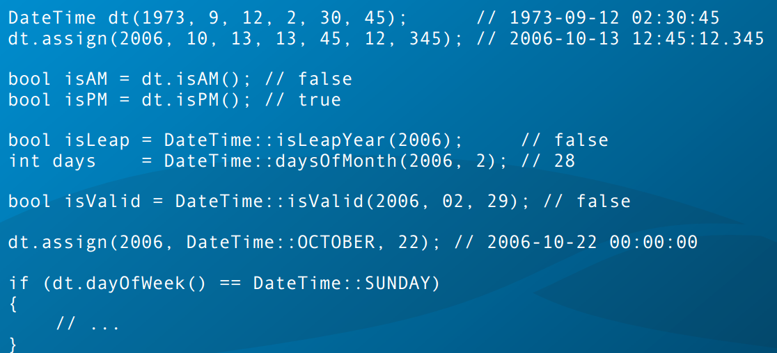

Slide 36
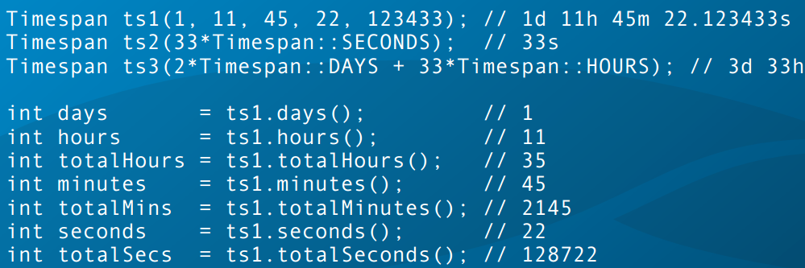
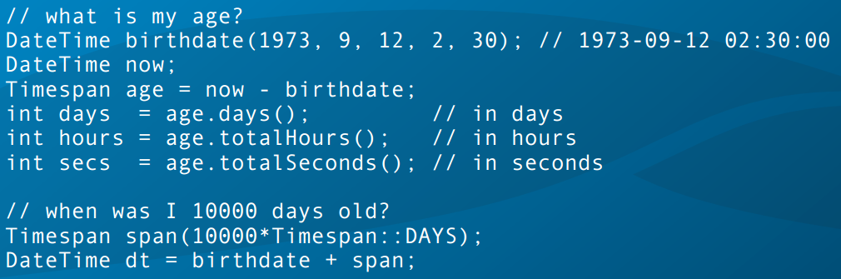

Slide 37
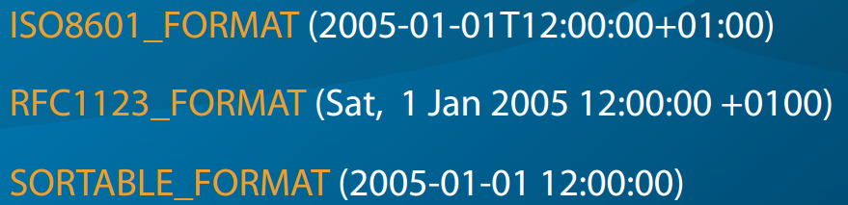
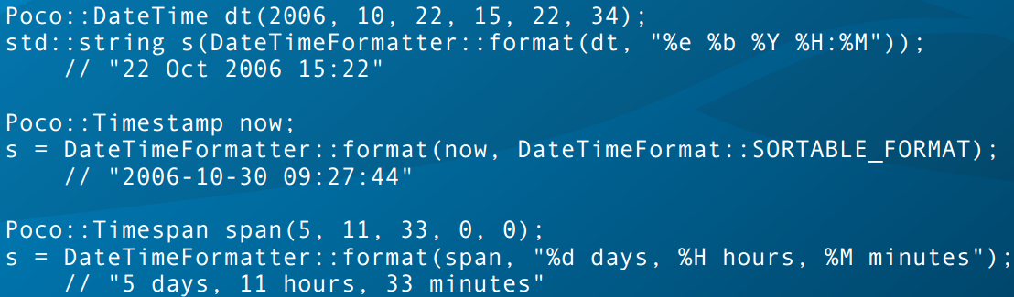
DateTimeFormatter

Slide 38
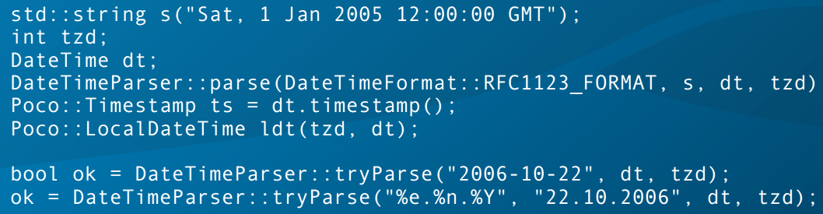
DateTimeParser

Slide 39
The File System

Slide 40
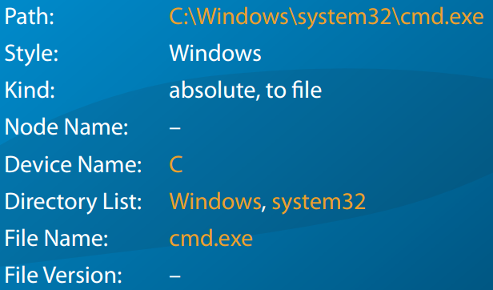
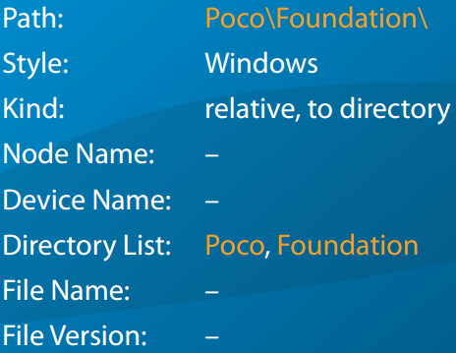
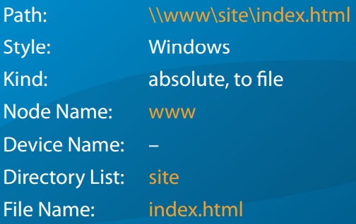
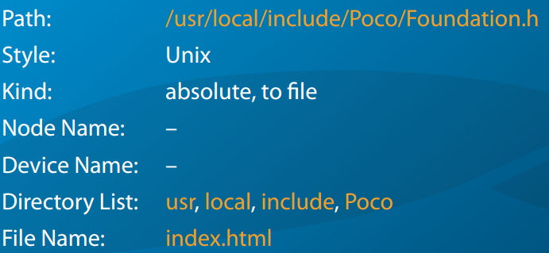
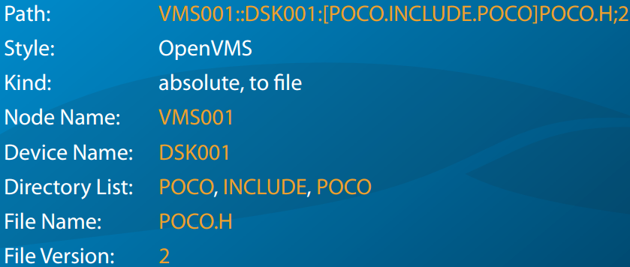
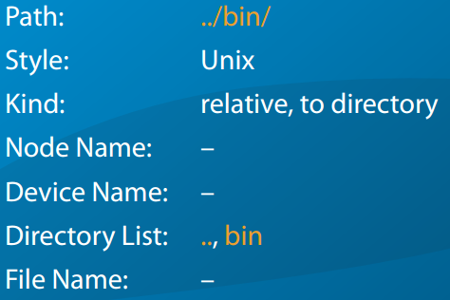

Slide 41
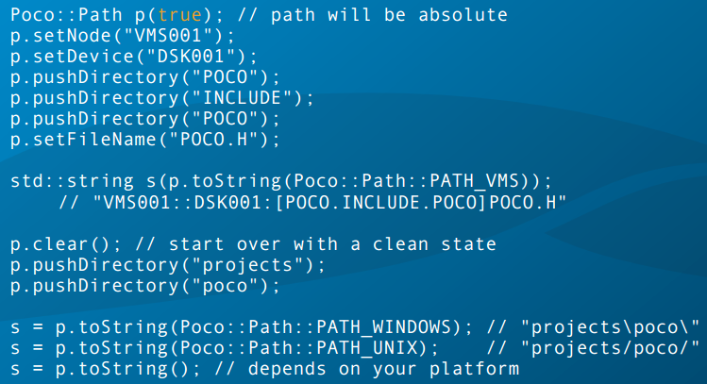
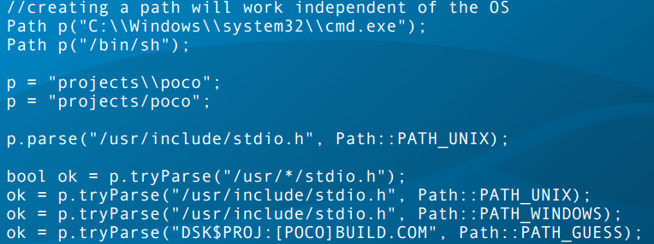

Slide 42
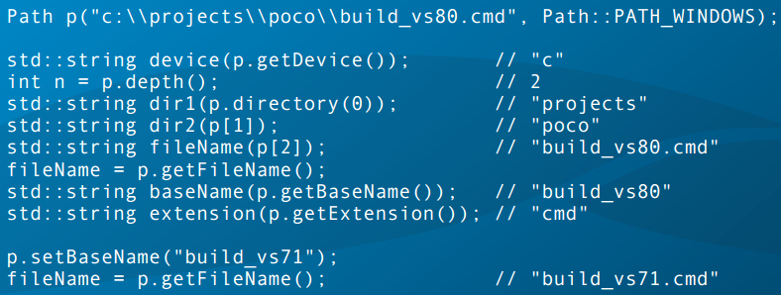
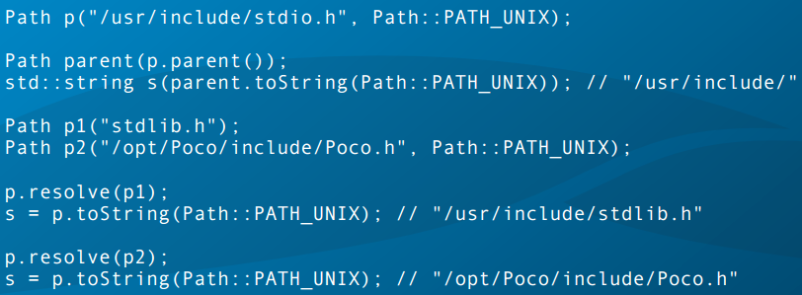

Slide 43
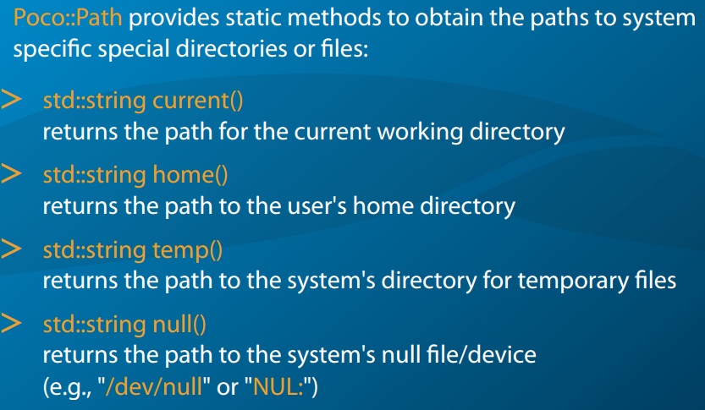
Special Directories And Files

Slide 44
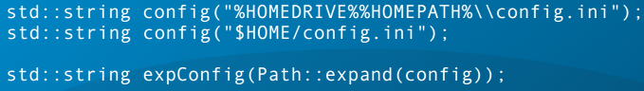




Slide 45



Slide 46
Q/A

